Slide 1


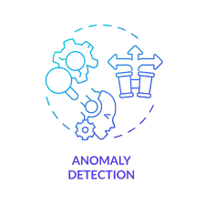
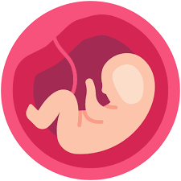
Fetal Brain Anomaly Detection Using Deep Learning
By Yuvashri Bhanuprakash

Slide 2
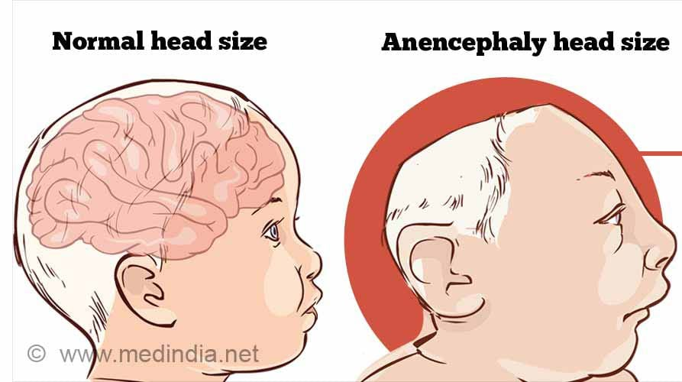
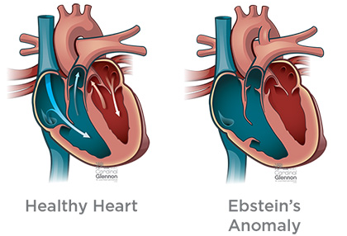
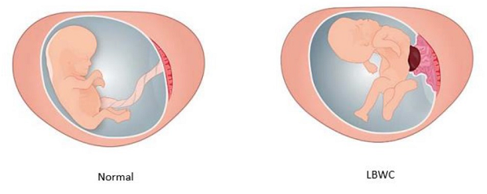
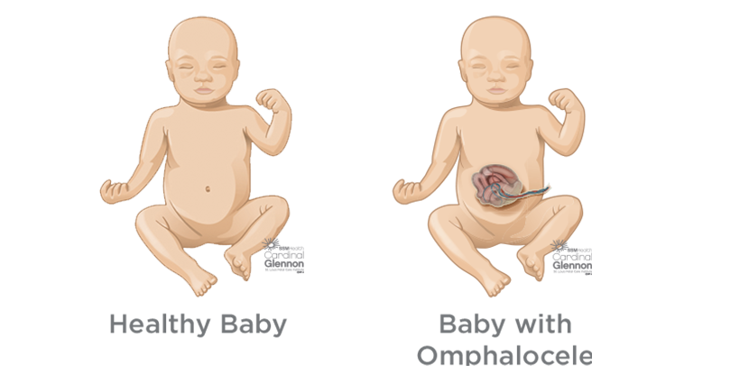
Introduction
What is Anomaly?
Identifying abnormalities or malformations in the developing of a fetus during pregnancy.
Brain Anomaly [1]
Heart Anomaly [2]
Limb and organ deformity [3]
Organ Abnormality [4]
Importance of identifying anomalies
Early detection is key to improving both immediate and long-term outcomes for affected infants and their families.
Improved Outcomes
Informed Decision-Making
Reduction of Risk
Advancement in Medical Technology
Enhanced Monitoring and planning
Psychological Preparedness
Personalized Care
1
2
3
4
5
6
7

Slide 3
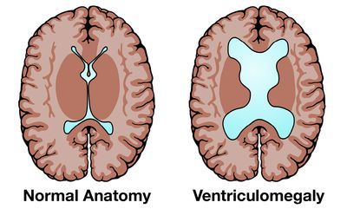
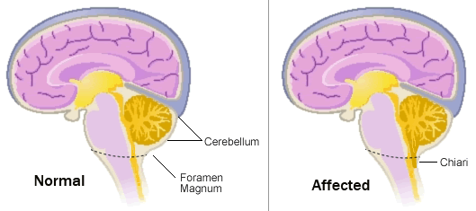
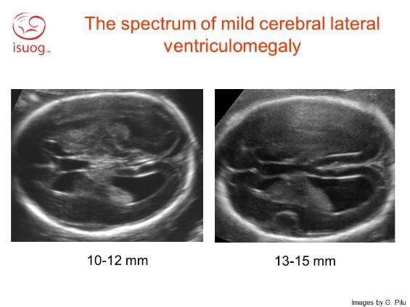
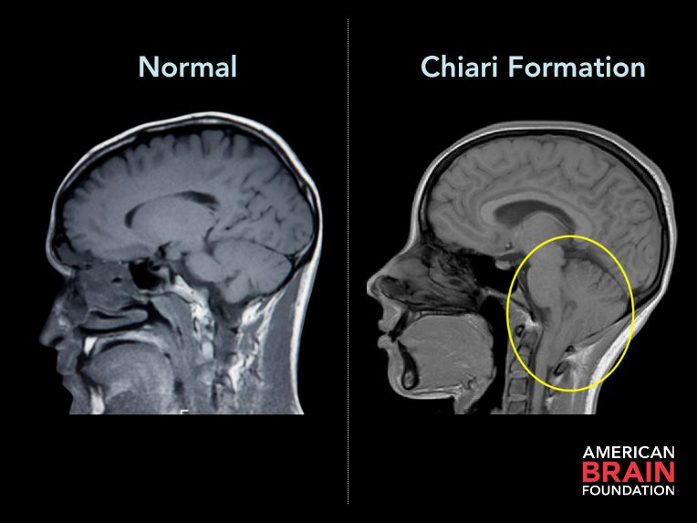
Difference between normal and abnormal fetus brain
Ventriculomegaly [5][6]
Chiari malformations[7][8]
Normal ventricles
Structures fit properly within the skull
Enlarged Ventricles
Protruded cerebellar tonsils

Slide 4
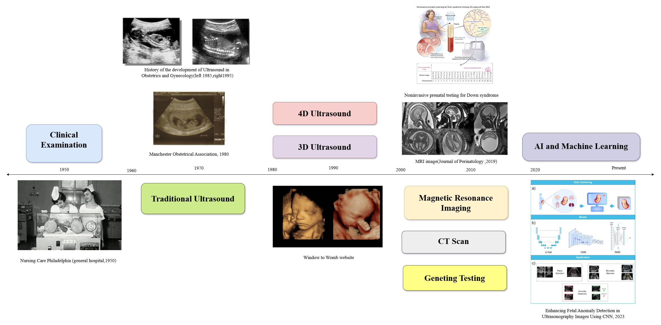

Background
Summarized timeline of evolution of technology in Fetal anomaly detections[9][10][11]

Slide 5









What are the current challenges and how AI can help?
Challenges
How AI can help?
Early Detection and Accuracy
Enhance image analysis by detecting patterns
Complexity and Variability
Trained on diverse and complex datasets
Image Quality and Resolution
Enhance image quality
Data Integration
Integrate and analyze multi-modal data
Reducing False Positives and Negatives
Optimize diagnostic accuracy

Slide 6











Aim and Objective
Development of Models
Standard CNN Model
Research and design the best approach
Training and optimize
Fine tune the model
Evaluate
Evaluate on different evaluating metrics
SeparableConv2d based model
Xception based Model
Get the best possible results from the model
Optimize the model
Compare the models
Choose the best model
GUI
Develop GUI using the best model and test the model

Slide 7

Methodology
Data Preprocessing
Normalization
Image resizing
Grayscale Conversion
Dimensionality Expansion
Duplication
Data augmentation
Model Development
Traditional CNN model
SeparableConv2D Model
Xception Model
Data Set
1768 Ultrasound images
16 categories of brain anomalies
State Comparison
Compare the models and conclude the best model along with accuracy and precision
Model Testing and Prediction
Use predict functions to test
Metrics- accuracy, precision, recall, f1 score
ROC AUC Curves
Confusion metrics
Training and evaluation
Ensuring robust learning
Explore different parameters
Train validate and test data
Tune the model to improve the accuracy
User Interface
Creating a user interface where users can upload a Fetal brain ultrasound image and the best model will classify it into different categories along with accuracy.

Slide 8
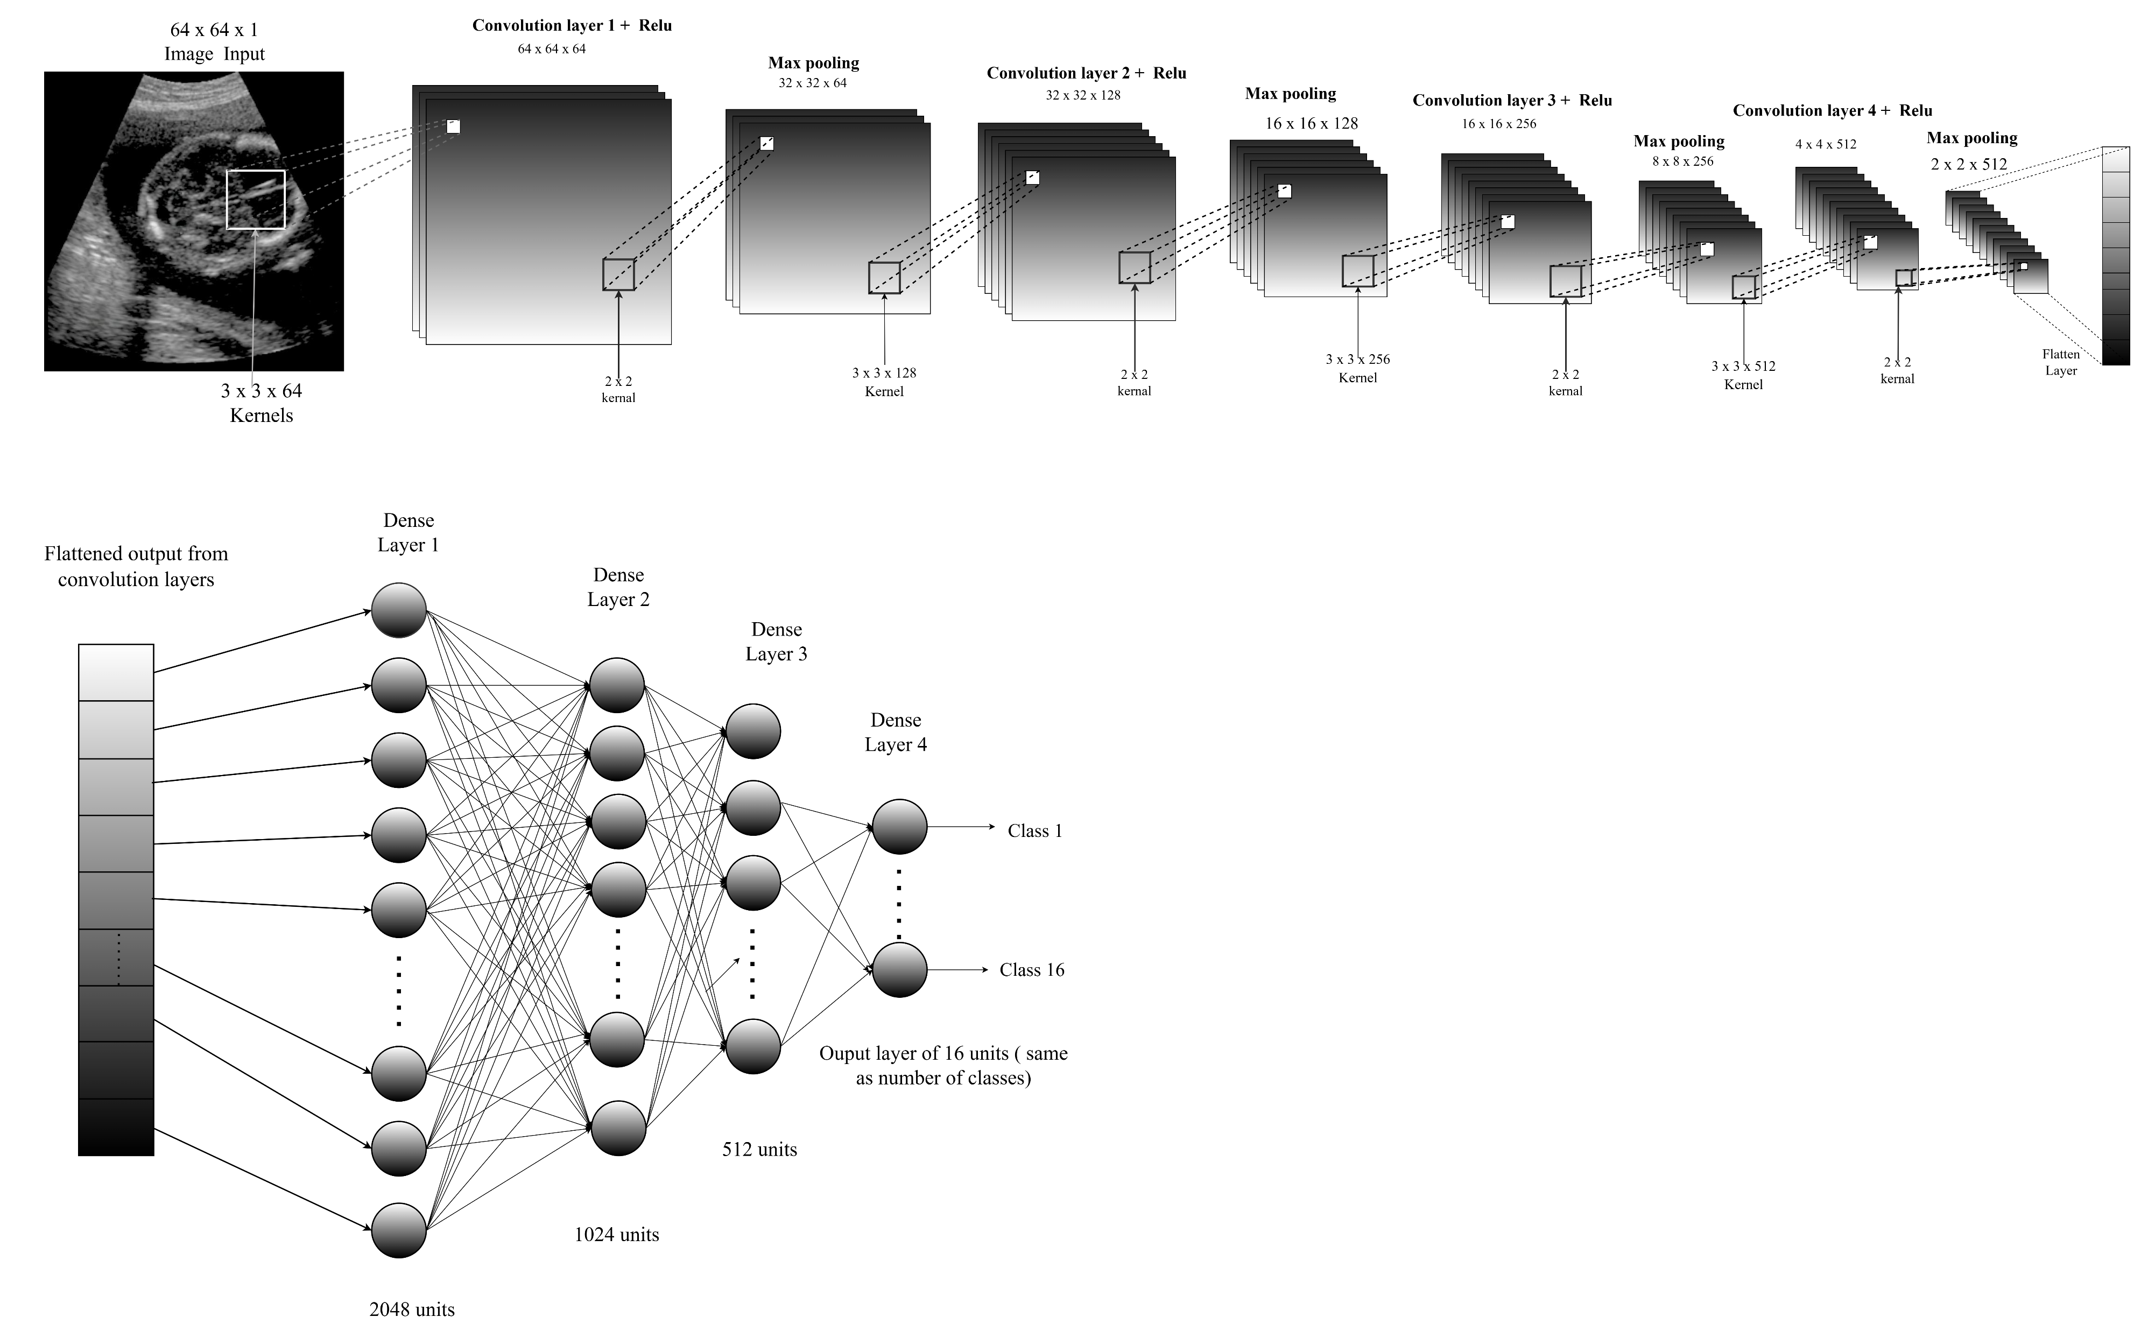

Standard CNN Model Architecture
Input: Grayscale images (image_size[0], image_size[1], 1).
Convolutional Blocks:
Conv2D → ReLU → MaxPooling → BatchNormalization → Dropout.
Repeated 4 times with filters:64, 128, 256,512.
Fully Connected Layers:
Flatten → Dense (2048, 1024, 512 units)
Output: Dense layer with softmax activation for class probabilities.

Slide 9
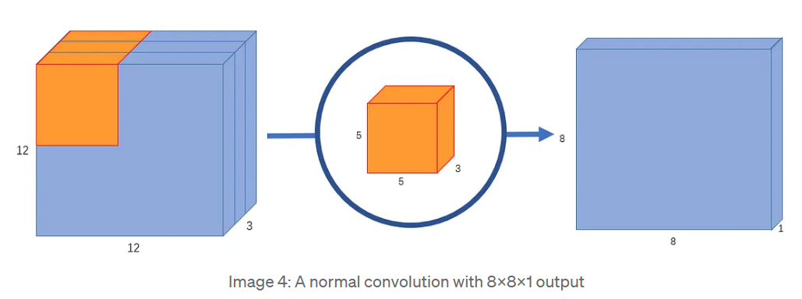
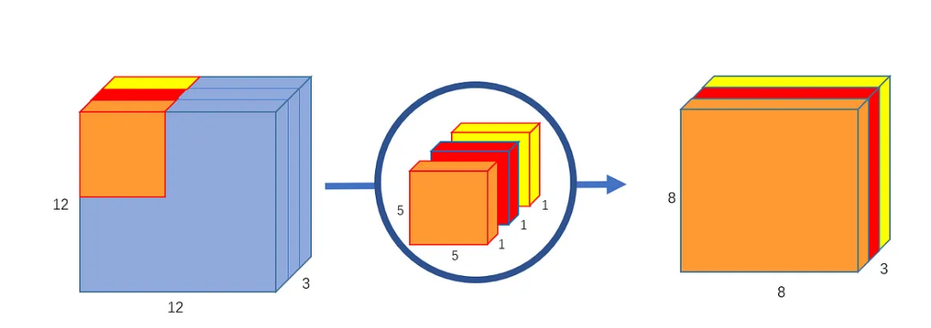
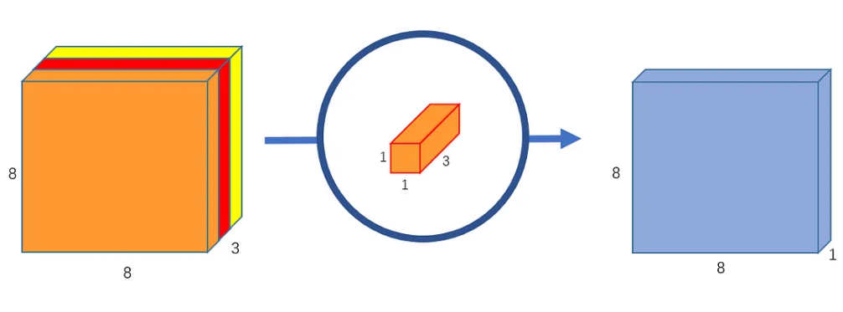
Difference between Traditional and Separable Convolutions
Standard Convolution
A normal convolution with 8x8x1 output [14]
Separable Convolution
Step 1: Depth wise Convolution
Step 2: Point wise Convolution
Depth wise convolution, uses 3 kernels to transform a 12x12x3 image to a 8x8x3 image [14]
Pointwise convolution transforms an image of 3 channels to an image of 1 channel [14]

Slide 10
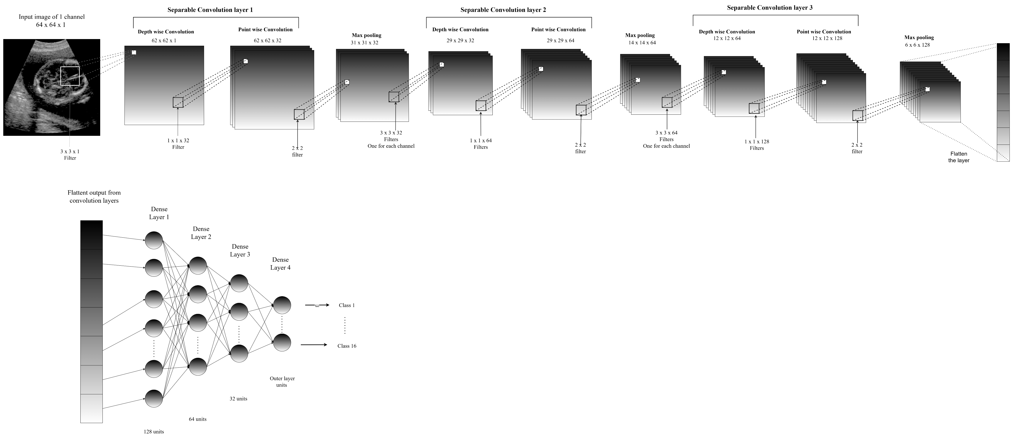
Separable based CNN Model Architecture
Input: Grayscale images (image_size[0], image_size[1], 1).
Convolutional Blocks:
SeparableConv2D → LeakyReLU → MaxPooling .
Repeated 4 times with filters: 32, 64, 128.
Fully Connected Layers:
Flatten → Dense (128, 64, 32 units), each with LeakyReLU.
Output: Dense layer with softmax activation for class probabilities.

Slide 11
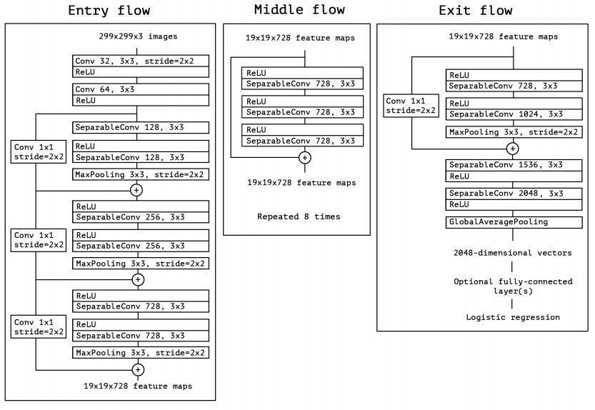
Xception-based CNN Model Architecture
Parameter | Value
Base Model | Xception (Pre-trained on ImageNet)
Top Layer Included | False (include_top=False)
Optimizer | adam
Loss Function | categorical_crossentropy
Metrics | accuracy
Class Weight Strategy | balanced
Learning Rate Reduction | ReduceLROnPlateau
Monitor (LR Reduction) | val_loss
Factor (LR Reduction) | 0.2 (20% reduction)
Patience (LR Reduction) | 3 (reduce after 3 epochs with no improvement)
Min Learning Rate | 0.001
Early Stopping | EarlyStopping
Monitor (Early Stopping) | val_loss
Patience (Early Stopping) | 6 (stop after 6 epochs with no improvement)
Restore Best Weights | TRUE
Epochs | 30

Slide 12
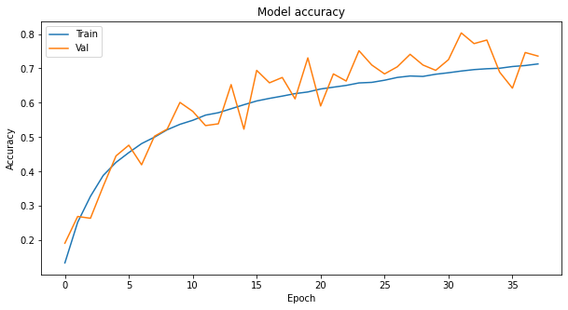
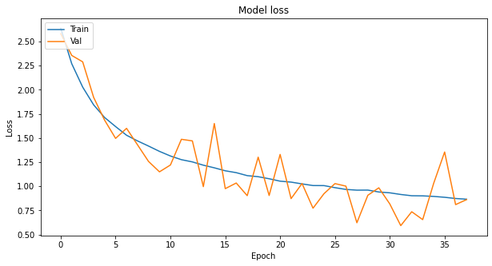
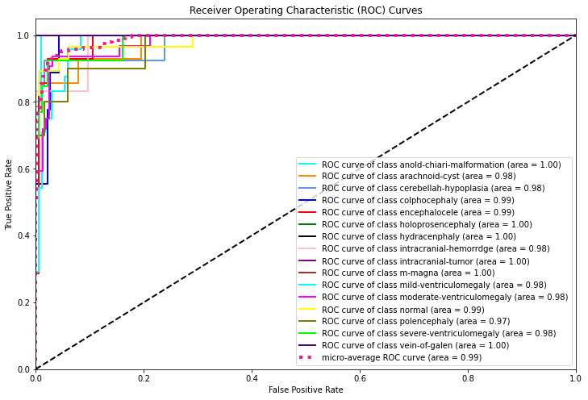
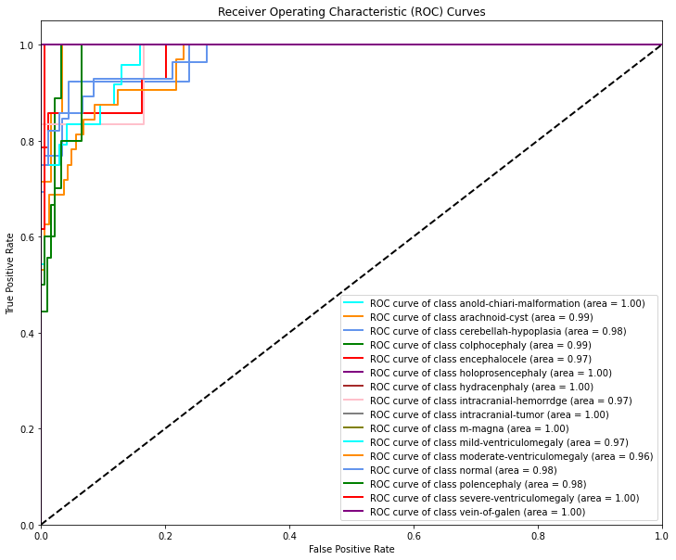
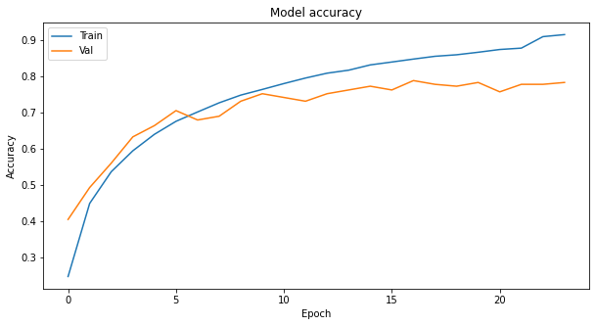
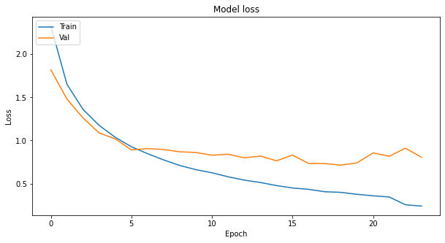
Comparing Loss, Accuracy and ROC Graphs Standard CNN vs. SeparableConv2D
Model/ Metrics | Accuracy Graph | Loss function graph | ROC AUC Curves
Standard CNN Model
Separable Conv2d Based model

Slide 13
Comparing Efficiency and Architecture
Standard CNN vs. SeparableConv2D
Category | Standard CNN Model | SeparableConv2D Model
Filters per Layer | 64, 128, 256, 512 | 32, 64, 128, 256
Fully Connected Layers | Dense(2048, 1024, 512) → ReLU | Dense(128, 64, 32) → LeakyReLU
Accuracy Score | 0.829 | 0.808
Precision | 0.843 | 0.830
Recall | 0.829 | 0.808
F1 Score | 0.831 | 0.811
Time Taken | 04:13:44 (4 hours, 13 minutes, 44 seconds) | 00:42:19 (42 minutes, 19 seconds)
Total Parameters | 20,962,064 | 612,185
Memory Usage | 79.96 MB | 2.34 MB
Efficiency | High computational cost due to large parameter count | More efficient with fewer parameters and reduced memory use
Training Speed | Slower (due to more parameters and complex operations) | Faster (due to fewer parameters and simpler architecture)

Slide 14
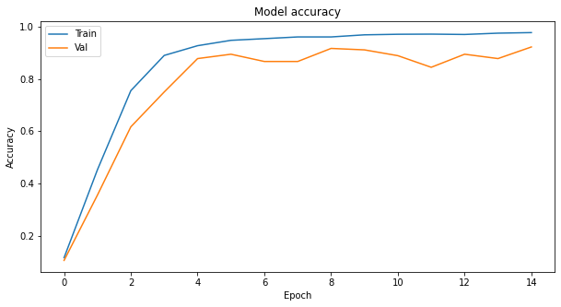
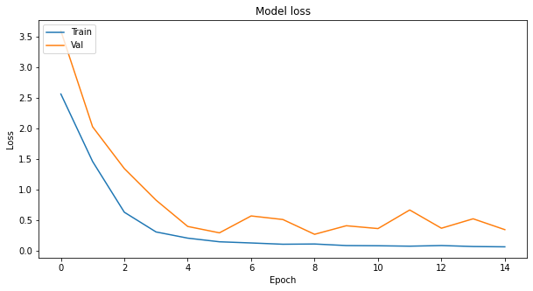
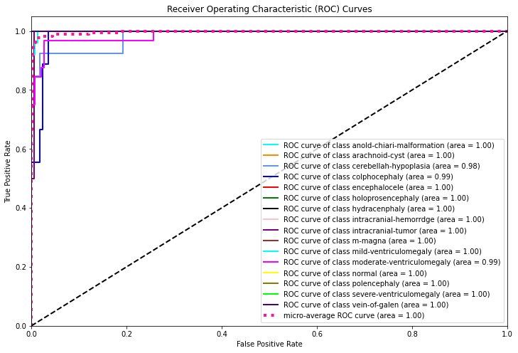
Comparing Loss, Accuracy and ROC Graphs Standard CNN vs. Xception Model
Model/ Metrics | Accuracy Graph | Loss function graph | ROC AUC Curves
Standard CNN Model
Xception Model

Slide 15
Performance metrics between Standard CNN and Xception Model
Model | Accuracy Score | Precision | Recall | F1 Score | Training Time | Total Params | Memory Used
Standard CNN | 0.829 | 0.843 | 0.829 | 0.831 | 04:13:44 | 20,962,064 | 79.96 MB
Xception Model | 0.95 | 0.952 | 0.95 | 0.949 | 04:57:07 | 20,894,264 | 79.71 MB
Better accuracy
Easier to fine-tune
Learns the patterns better
Faster inference
Why Xception?
Uses fewer parameters
Less computational overhead
Lowers the risk of overfitting
Efficient

Slide 16
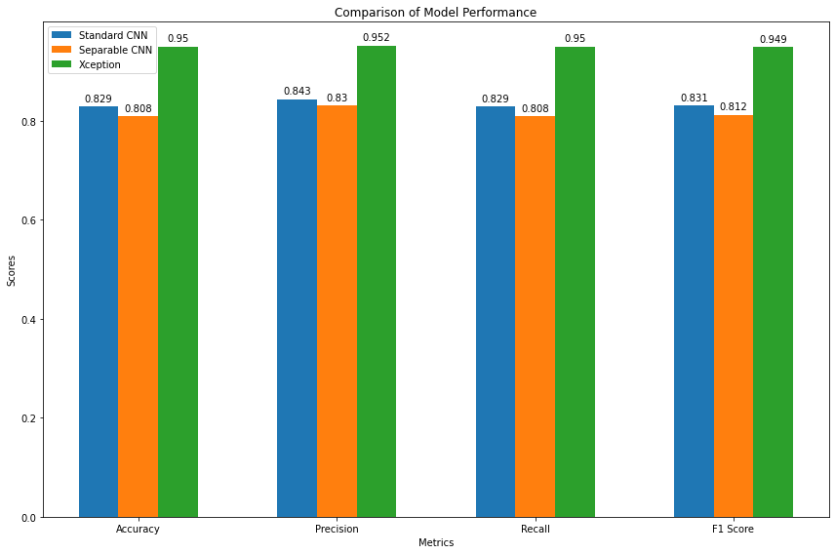
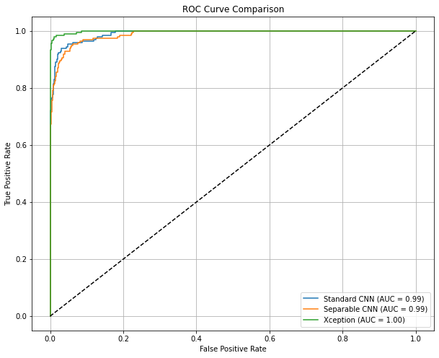
Summarizing the three Models
Performance Metrics of the three models
ROC AUC Curves of the three models

Slide 17
Conclusion
Challenges Faced
Data Set
Data Imbalance
Limitations
Overfitting
Limited diagnostic scope
Future Scope
Addressing overfitting
Expanding anomaly categories
Overfitting
Model Stability and accuracy for Standard CNN Model
Can produce false positives
Not suitable for mobile or edge computing systems
Optimizing for low resources
Multi-Model Data Integration
1
Advanced deep learning techniques improve the accuracy of detecting fetal anomalies in ultrasound imaging.
2
The project develops and evaluates three deep neural networks (Standard CNN, Separable CNN, Xception) to enhance anomaly detection
3
The Xception model surpasses Standard CNN in accuracy, precision, recall, and efficiency, with a near-perfect AUC score
4
The Xception models cut computational costs significantly while maintaining high performance compared to the Standard CNN
5
The improved models enhance early fetal anomaly detection, enabling timely interventions and potentially reducing healthcare costs

Slide 18
References
[1] Anencephaly - causes, symptoms, diagnosis and treatment (2018) Medindia. Available at: https://www.medindia.net/health/conditions/anencephaly.htm#google_vignette (Accessed: 16 September 2024).
[2] Ebstein’s anomaly diagnosis & treatment: Cardinal Glennon (no date) Diagnosis & Treatment | Cardinal Glennon. Available at: https://www.ssmhealth.com/cardinal-glennon/fetal-care-institute/fetal-heart-program/heart-conditions/ebsteins-anomaly (Accessed: 16 September 2024).
[3] Isuog (no date) Limb body wall complex (LBWC), International Society of Ultrasound in Obstetrics & Gynecology. Available at: https://www.isuog.org/clinical-resources/patient-information-series/patient-information-pregnancy-conditions/abdomen/limb-body-wall-complex-lbwc.html (Accessed: 16 September 2024).
[4] Omphalocele Diagnosis & Treatment: Cardinal Glennon (no date) Diagnosis & Treatment | Cardinal Glennon. Available at: https://www.ssmhealth.com/cardinal-glennon/fetal-care-institute/fetal-conditions-we-treat/abdomen-intestines/omphalocele (Accessed: 16 September 2024).
[5] Isuog (no date b) Ventriculomegaly, International Society of Ultrasound in Obstetrics & Gynecology. Available at: https://www.isuog.org/clinical-resources/patient-information-series/patient-information-pregnancy-conditions/brain/ventriculomegaly.html (Accessed: 16 September 2024).
[6] Ventriculomegaly (no date a) UCSF BCH Fetal Treatment Center - Ventriculomegaly. Available at: https://fetus.ucsf.edu/ventriculomegaly/ (Accessed: 16 September 2024).
[7] Chiari malformation (2023) American Brain Foundation. Available at: https://www.americanbrainfoundation.org/diseases/chiari-malformation/ (Accessed: 16 September 2024).
[8] Chiari malformation: Center for Craniofacial Care (no date) Chiari malformation | Center for Craniofacial Care | Children’s Hospital of Richmond at VCU. Available at: https://www.chrichmond.org/services/center-for-craniofacial-care/conditions-treated/chiari-malformation (Accessed: 16 September 2024).
[9] Kyliecross (2024) 12 weeks ultrasound, Flickr. Available at: https://www.flickr.com/photos/kyliecross/3180930788 (Accessed: 08 September 2024).
[10] Woo, Dr.J. (no date) A short History of the development of Ultrasound in Obstetrics and Gynecology, History of ultrasound in Obstetrics and Gynecology, part 3. Available at: https://www.ob-ultrasound.net/history3.html (Accessed: 08 September 2024).
[11] Care of premature infants (no date) Nursing, History, and Health Care Penn Nursing. Available at: https://www.nursing.upenn.edu/nhhc/nurses-institutions-caring/care-of-premature-infants/ (Accessed: 08 September 2024).
[12] Sarkar, A. (2020) Xception from scratch using tensorflow - even better than inception, Medium. Available at: https://towardsdatascience.com/xception-from-scratch-using-tensorflow-even-better-than-inception-940fb231ced9 (Accessed: 26 August 2024).
[13] https://www.flaticon.com/
[14] Wang, C.-F. (2018) A basic introduction to separable convolutions, Medium. Available at: https://towardsdatascience.com/a-basic-introduction-to-separable-convolutions-b99ec3102728 (Accessed: 18 September 2024).

